Slide 1
File I/O

Slide 2
Streams

Slide 3
Streams
A stream is an object that enables the flow of data between a program and some I/O device or file
  If the data flows into a program, then the stream is called an input stream
  If the data flows out of a program, then the stream is called an output stream
10-<number>
Copyright © 2012 Pearson Addison-Wesley. All rights reserved.

Slide 4
Streams
Input streams can flow from the keyboard or from a file
  System.in is an input stream that connects to the keyboard
Scanner keyboard = new Scanner(System.in);
Output streams can flow to a screen or to a file
  System.out is an output stream that connects to the screen
  System.out.println("Output stream");
10-<number>
Copyright © 2012 Pearson Addison-Wesley. All rights reserved.

Slide 5




Why Streams?

Slide 6
Node Streams
Node Stream

Slide 7
Filter Streams
Filter Stream

Slide 8
Filter Streams
10100011
11001100
Byte Stream
11001100
11001100

Slide 9
Filter Streams
A
H
Character Streams also known as Reader / Writer
E
D

Slide 10
Character vs. Byte Streams
A character stream manages 16-bit Unicode characters
A byte stream manages 8-bit bytes of raw binary data
  A program must determine how to interpret and use the bytes in a byte stream
  Typically they are used to read and write sounds and images
The InputStream and OutputStream classes (and their descendants) represent byte streams
The Reader and Writer classes (and their descendants) represent character streams

Slide 11
Types of Streams
InputStream / OutputStream
  Base class streams with few features
  read() and write()
FileInputStream / FileOutputStream
  Specifically for connecting to files
ByteArrayInputStream / ByteArrayOutputStream
  Use an in-memory array of bytes for storage!
BufferedInputStream / BufferedOutputStream
  Improve performance by adding buffers
  Should almost always use buffers
BufferedReader / BufferedWriter
  Convert bytes to unicode Char and String data
  Probably most useful for what we need

Slide 12
Reading from File

Slide 13
Reading From File
Hello World
Pakistan is our homeland
input.txt

Slide 14
ReadFile. java
/* This program reads file line by line and
prints them on to the console */
import java.io.*;
public class ReadFile {
public static void main (String args[ ]) {
FileReader fr = null;
BufferedReader br = null;
try {
fr = new FileReader("input.txt");
br = new BufferedReader(fr);
//continue

Slide 15
ReadFile. java
String s = br.readLine();
while (s != null) {
System.out.println(s);
s = br.readLine();
}
br.close();
fr.close();
} catch (IOException ex) {
System.out.println(ex);
}
}// end of main
}//end of class

Slide 16

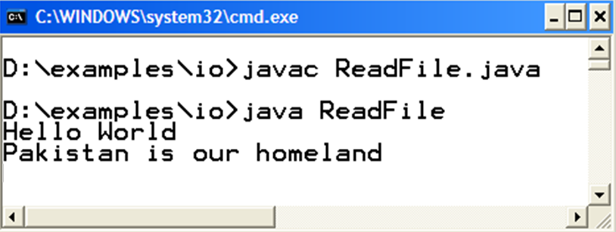
Compile & Execute

Slide 17
Writing into File

Slide 18
WriteFile. java
// This program writes the strings into the file “output.txt”
import java.io.*;
public class WriteFile {
public static void main (String args[ ]) {
FileWriter fw = null;
PrintWriter pw = null;
try {
// if file does not exist, it automatically create for you
fw = new FileWriter("output.txt");
pw = new PrintWriter(fw);
//continue..

Slide 19
WriteFile. java
String s1 = "Hello World";
String s2 = " Visual Programming";
pw.println(s1);
pw.println(s2);
pw.flush();
pw.close();
fw.close();
} catch (IOException ex) {
System.out.println(ex);
}
}//end of main
}//end of class

Slide 20
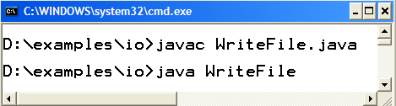
Compile & Execute
Hello World
Visual Programming
output.txt

Slide 21
Why Streams

Slide 22
Reading Data from
File
FileReader fr = new FileReader(“input.txt”);
BufferedReader br = new BufferedReader (fr);
Console
FileReader fr = new FileReader(FileDescriptor.in);
BufferedReader br = new BufferedReader (fr);
Network
InputStream is = s.getInputStream() ;
BufferedInputStream br = new BufferedInputStream (is) ;
//where “s” is the socket

Slide 23
Writing Data to
File
FileWriter fw = new FileWriter(“output.txt”);
PrintWriter pw = new PrintWriter (pw);
Console
FileWriter fw = new FileWriter(FileDescriptor.out);
PrintWriter pw = new PrintWriter (fw);
Network
OutputStream os = s.getOutputStream() ;
PrintWriter pw = new PrintWrtier (os) ;
//where “s” is the socket

Slide 24
Problem
Take input from console
Write that input to text file with line numbers
Program should only exit when user press enters without typing anything

Slide 25
Persistence Data AddressBook
Want to store addressbook persistently
  Load data when program starts execution
  Save Data when program is about to finish

